Slide 1
AC to DC converter
OBJECTIVE :- Design an LED driver to convert 230V, 50 Hz AC mains supply to 12V, 300 mA

Slide 2
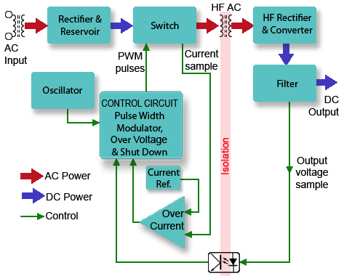
BLOCK DIAGRAM

Slide 3
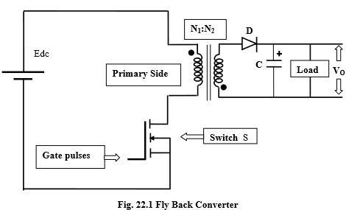
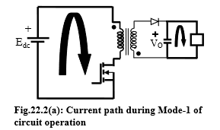
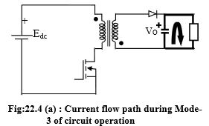
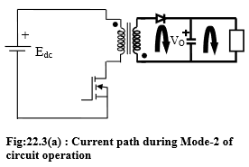
Principle and Working of Flyback Converter

Slide 4
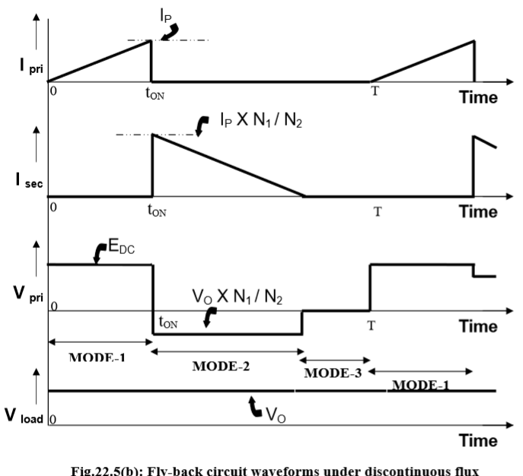
GRAPHS

Slide 5
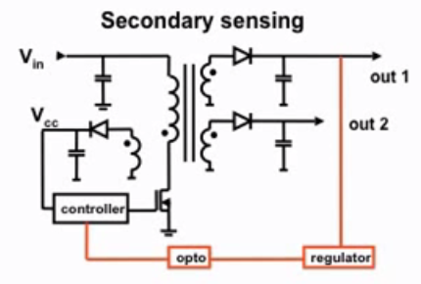
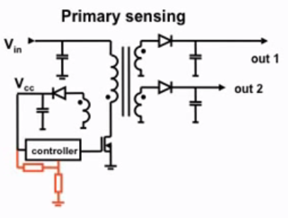
Types Of Sensing

Slide 6
PFM controller IC- AP1682
The AP1682 is a high performance AC/DC universal input Primary Side Regulation Controller with Power Factor Correction for LED driver applications.
The device uses Pulse Frequency Modulation (PFM) technology to regulate output current while achieving high power factor and low THD.
Some of the product features include:-
Open-load and Reload Detection
Over Voltage and Short Circuit Protection
Over Temperature Protection
Over Current Protection
Cost Effective Total PFC LED Driver Solution

Slide 7
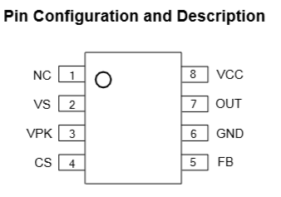
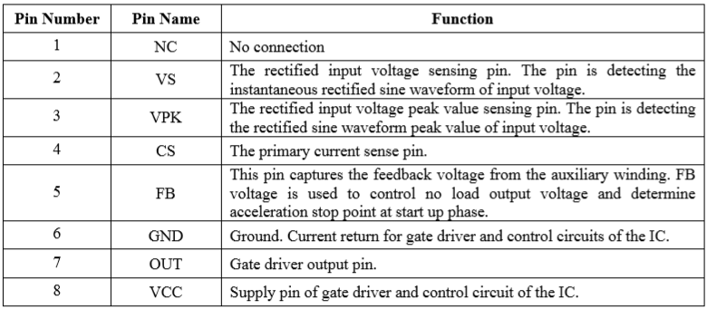
PIN CONFIGURATION

Slide 8
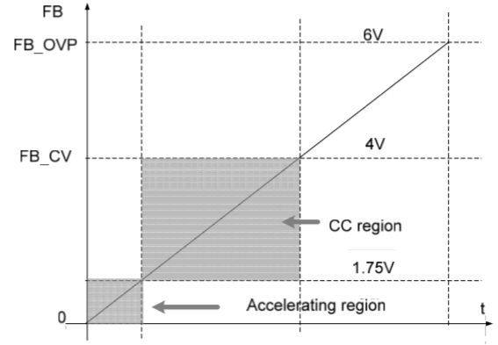
Current and voltage control
Voltage sensing:-
FB pin should be at 4V or less at no load condition. If the load voltage increases then the voltage at FB should be >4V.
Current Sensing:-
The output current is related to input current(primary) by:
I1*N1=I2*N2
Therefore, input current follows the input voltage, which shows PWM function can be used to control I1.
Thus, Pulse Frequency Control is done based on the voltage at CS pin

Slide 9
Values used during calculation
Typical values required for operation:
Vcc=> 18V - Startup threshold.
8V - UVLO voltage threshold.
FB=> 3.2V at no load condition.
if >3.2V IC stops firing.
OUT=> gives the PFM signal.
CS=> 1V
VS/VPK=> 0-1
We take VS=VPK= 3V

Slide 10
MOSFET
To perform the switching we use MOSFET . The PWM signal from the IC performs switching operation by providing voltage to the gate of MOSFET.
MOSFET selection is done by checking the voltage and current ratings for a MOSFET. A balance between low gate charge and R_{DS(ON)} must be achieved in order to keep the temperature of the MOSFET within specification.

Slide 11
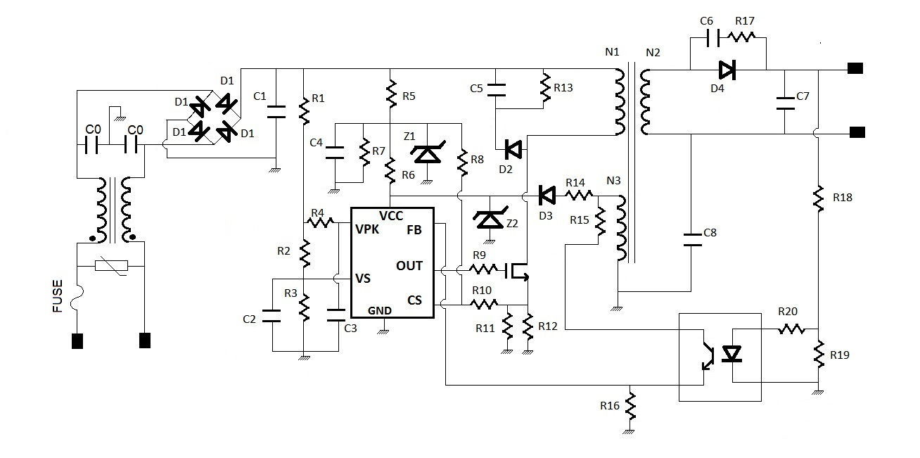
Circuit Diagram

Slide 12
Calculations
AC mains voltage 230 Vrms
Nominal DC output voltage: V_{O}=12 V
Output constant current: I_{O}=2 A
Assuming,
Full load switching frequency : f_{SW} = 80kHz
Transformer efficiency : η = 80%
Duty Cycle = 0.46
Efficiency=Pout/Pin= 0.8
Pout = (V_{o}+V_{d})*I_{o}
where I_{o}=2.05 A, Vo=12 V and Schottky diode forward voltage: V_{d} = 0.4 V
Pin =12.4*2.05/0.8 = 31.775 W

Slide 13
Ip,avg=Pin/Vpri = 31.775/326
Therefore, Ip,avg=97 mA
Ip,pk=2*Ip,avg/D
=> Ip,pk =424 mA
Vpri=L_{p} *di/dt
Lp=(Vpri*D*Tsw)/ Ip,pk
=>Lp=4.4 mH
Ip*Np=Is*Ns
Is,avg= Ip,avg*Ns/Np
Where Is,avg= 2.05 mA and Ip,avg=Ip,pk*(1-D)*0.5
Therefore 2.05=0.5*(1-0.46)*0.424*Np/Ns
=>Np/Ns =179/10

Slide 14
Also,
(Ls/Lp) = N² =(Ns/Np)²
Therefore, Ls= 9.5*10⁻³*Lp
Ls=13.73 uH
Thus taking turns as:- Np=179 and Ns=10
Vaux /Naux=(Vo+V_{d}) /Ns
Naux=Ns*Vaux/(Vo + Vd) where we want 19 V at auxillary winding
Naux=10*19V/(12.4) =16

Slide 15
DESIGN OF FILTER
MOV:- When the transient voltage across the varistor is equal to or greater than the rated value, its resistance suddenly becomes very small turning the varistor into a conductor due to the avalanche effect of its semiconductor material. Thus clipping-off any voltage spikes.
A line filter is placed between an electronic equipment and a line external to it, to attenuate conducted radio frequencies, also known as electromagnetic interference (EMI) -- between the line and the equipment.
In this a choke/inductor is used to block higher-frequency alternating current (AC) in an electrical circuit, while passing lower-frequency or direct current (DC).
The choke's impedance increases with frequency. Its low electrical resistance passes both AC and DC with little power loss, but it can limit the amount of AC due to its reactance.

Slide 16
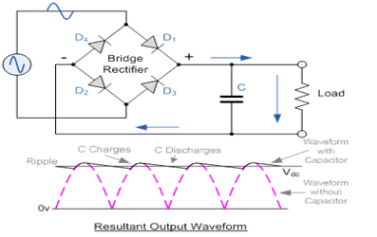
PIV>326-1 (=Vm-Vf )
=> PIV>325
So we choose 1N4005
As its reverse breakdown voltage = 600V
Input=> 230V(Vrms) , 50 Hz ,AC mains supply
Output => FULL RECTIFIED WAVE
Vout=>326V, 100Hz

Slide 17
Taking choke coil of 39 mH , R of the choke coil = 1 ohm
f_{sw}=1/(2*3.14.sqrt(L*2*Cy)
Therefore, Cy= 1/ 4*3.14²*f_{sw}²*L*2 where f_{sw}=80 KHz
Cy=50 pF
MOV selection
Clamping voltage of MOV should be 20% more than the operating peak voltage
=>1.2*230*sqrt(2) = 400V
MOV used is 07D431K having Vrms=275V
FUSE used
Max current= 482mA therefore current rating = 1A
To convert full rectified wave to unregulated DC.
The capacitor should be such that the discharge time is very high.
Therefore, RC>>(1/f) Where R_{l}=Vin/Iin = 326/(482mA) = 676 ohm
C >> (1/(80*676*1000))
=> C1 >> 17 uF Therefore take C1=100uF

Slide 18
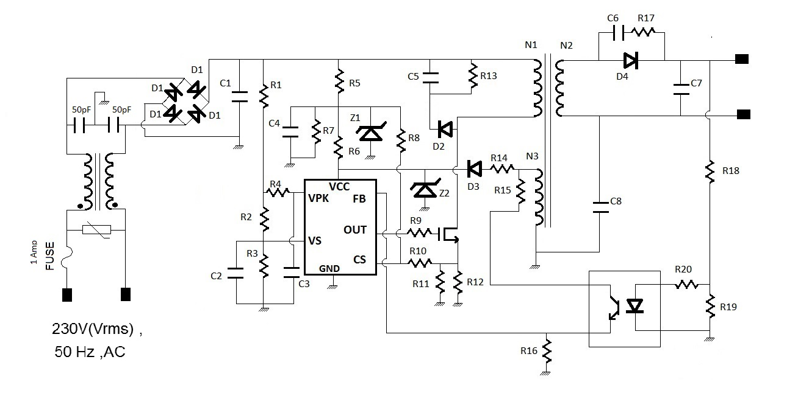

Slide 19
Vs and VPK PIN CALCULATIONS
The VPK pin detects the peak average value of the sinusoidal input. This means that when Vin = Vpk,avg=(2*Vrms*sqrt(2))/3.14
Thus by voltage divider equation we get
(R2+R3)/(R1+R2+R3) = (3*3.14)/(2*Vrms*sqrt(2)) ­­­­­­­­­­­­­­………………………….eqn (1)
The VS detects the input sine wave. This means that when Vin reaches its peak value then voltage at point 3V
Thus by voltage divider we get
R3/(R1+R2+R3)=3/(Vrms*sqrt(2)) ………………………………………eqn (2)
Where Vrms = 230 V
Solving Eqn(1) we get
(R1+R2+R3)/(R2+R3)=69.2
and Solving Eqn(2) (R1/R3)+(R2/R3) = (3*3.14)/(2*230*sqrt(2))

Slide 20
taking R3=1K
we get R1-68.2*R2 = 68.2
R1+R2 = 108
We get R1=106 K ohm R2=570 ohm R3=1K ohm
FINDING CURRENT:-
V=IR, P=I²R (230Vrms→ 325.269V DC)
=>I = 326/(106+ 0.570 +1) => I= 3 mA
Recommended value of R4 and C3
R4=330K
C3=C2=1uF/16V so that corner frequency <10 Hz

Slide 21
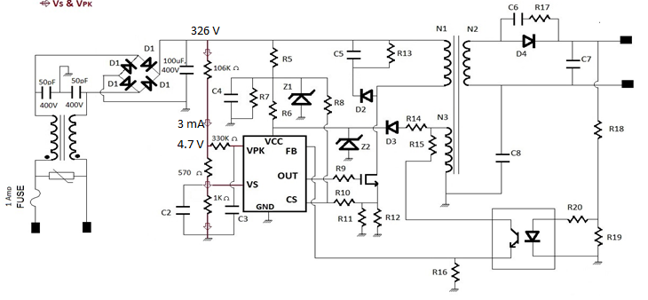

Slide 22
Calculations for the Supply (Vcc) circuit
Zener diode taken
Z1=20V (12.5 mA, 45 mA) : -IN4747, Z2=18V (14 mA, 50 mA) :-IN4746
Maximum zener current that can flow:-
I_{Z1}=45 mA I_{Z2}=50 mA
Applying voltage divider we get
R7*326/(R7+R5) =20 V
R5/R7 =15.3 ………(3)
(20-18)/(5mA) =R6
R6=400 ohm
Using V=IR , R5= (306/55mA) = 5.6K
Therefore, from eqn(3) we get R7 = 4K
I_{zk}=45 mA I=50 uA
V=IR V=(20-1)V
=>R8=19/50uA = 380K

Slide 23
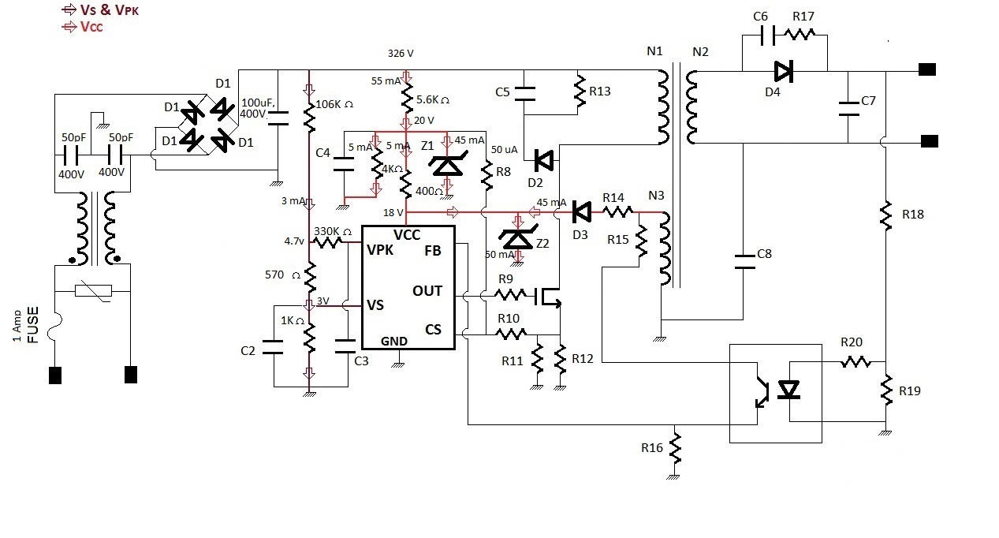

Slide 24
Auxillary supply
V=IR=> R14=(19-18.4 )/(45 mA)
=>R14=13.3 ohm
SELECTION OF MOSFET
Voltage stress across MOSFET
Voltage stress= sqrt(2)*V_{in_rms} + N_{t}*12.4+V_{spike}
= 755.36 V
Here, the V_{spike} is estimated about 100V and N_{t} (= Np/Ns= 179/10) is the turn ratio. Therefore, a 600V MOSFET device can be used here.
For MOSFET R_{ds,on}=0.6 ohm

Slide 25
CALCULATIONS FOR CS PIN
Voltage at CS pin=1V voltage at node below MOSFET =0.9-( Ip,pk*R_{ds,on} )
Vpri= 326-0.828 ==326V and Ip,pk= 0.424 A
let R10=1 M ohm
0.424 A=0.508/R_{eq} => R_{eq}=6/5 =1.2 ohm
R11= 2 ohm and R12=3 ohm

Slide 26
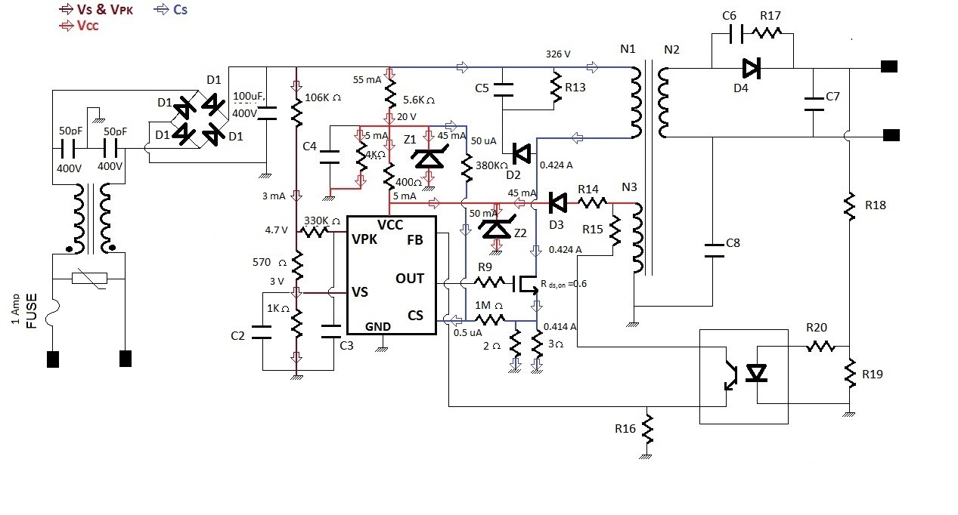

Slide 27
CALCULATIONS FOR SNUBBER CIRCUIT
Let leakage inductance=10% of L_{p}
=>L_{k}=0.44 mH
Energy stored in Leakage inductor=0.5*L_{k}*I² =0.5*0.44*0.424*10⁻³ =39.55 uJ
Power transferred from L_{k} to snubber circuit = 3.164 W
P=(V_{snubber} )²/R_{snubber} where V_{snubber} =Vin – Vspike =326-100 =226V
R_{snubber} =R₁₃= 226*226/3.164 =16 K
Now, Cs >>Tsw/Rsnubber => Cs >>100/(8*16)Rs
Cs=C₅=1nF, 300V

Slide 28
Snubber circuit for secondary coil
Vs=Vo+(Vpri*Ns/Np) => 12+326*10/179 => 38.2V
Power dissipation by the capacitor= 0.5*C*(Vs)²*2*f_{sw}
Calculating the capacitance by taking the value of power dissipation to be ¼ watt.
We get ¼ = C*1459.24*80 * 10³ => 2 nF
Therefore C6=2 nF/ 50 V
Now V= I*R and I = 2.02
So, R17=(38.2/2.02) = 20 ohm

Slide 29
FB PIN CALCULATIONS
FB pin reference voltage = 3.2 V when V_{cc}= 18V
So if the load voltage increases, we want FB pin to detect this rise thus we give it a voltage greater than 3.2V.
(19-18.4)/R =45 mA
R14=15 ohm
For the optocoupler FODM2701 the conditions are: if I_{f}=10 mA then V_{ce}=0.3 V and I_{c}=2 mA
Therefore, V=IR
R15=(19-4.3)/(2mA) =7.4 K ohm
R16=(4)/(2mA) =2K ohm
Optocoupler used has I_{f}=10 mA (V_{f} = 1.25V )
R20=1.8*10/(10mA) =180 ohm
Using V=IR , R18=10/(50 mA) =200 ohm
Also, R19= 3/(40mA)= 75 ohm

Slide 30
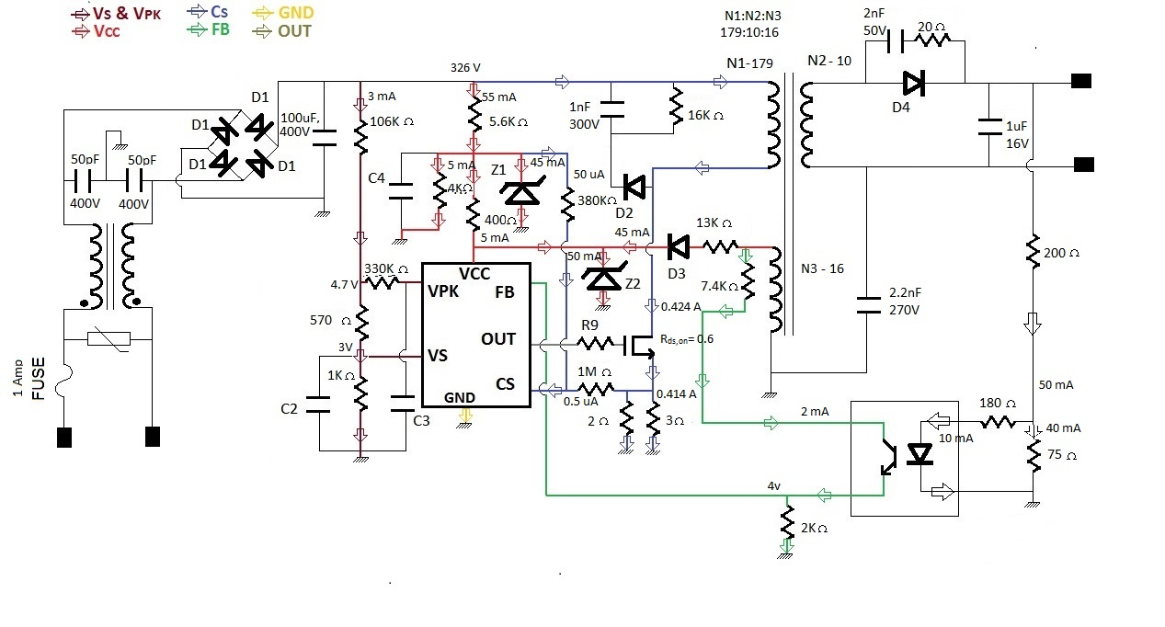

Slide 31
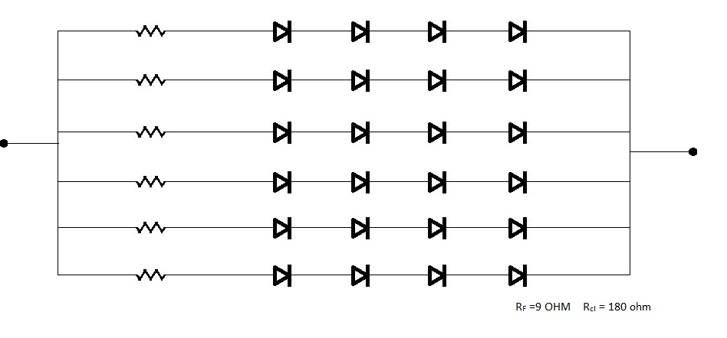
OUTPUT := 12V , 2A
LED’s are connected as 4 in series then 6 branches in parallel
Resistance of one LED=9 ohm
RC>>1/f_{sw}
Total resistance of combination of LED’s and current limiting resistor
(180 ohm)= 36 ohm
C>>1/(36*80*1000)
=>C7>>0.340 uF
so take C7=1 uF / 16V
C8 = 2.2nf/275V
R9= 20 ohm

Slide 32

FINAL CIRCUIT

